Slide 1
Advanced Control Implementations with Modelica
FMH606 Master’s Thesis 2023 Industrial IT and Automation Carl Magnus Bøe Supervisor USN: Finn Haugen Supervisor Yara: Anushka Perera

Slide 2
Introduction
Background information
Modelica
Functional Mock-up Interface (FMI)
SIMULINK
Model Predictive Control Toolbox
Open-source equation-based modelling language
Graphical and text based
Multi domain support
Vendor neutral standard for model exchange
Defines a container and an interface
Open standard
Commercial tool from MathWorks
Graphical extension of MATLAB
Used to simulate and analyse dynamic models
Block based
Commercial toolbox for SIMULINK
Example code
SIMULINK blocks

Slide 3
Introduction
Background information
Modelica
Functional Mock-up Interface (FMI)
SIMULINK
Model Predictive Control Toolbox
Modelica
Modelica
External Object

Slide 4
Introduction
Revised scope
Modelica
External Object
Modelica
External Object
FMU
Python

Slide 5
Existing Options
Linear MPC Modelica Library
JModelica
Open-source
Last updated 2016
Not compatible with Modelica 4.0
Discontinued in 2019
Assimulo
PyFMI
FMI Library
FMPy - Dassault Systèmes
NLopt
Free Python FMI library
Graphical user interface
Validate FMUs
Export to Jupyter Notebook, Modelica and Cmake
Web App
Open-source optimization library
C, C++, MATLAB, Fortran, Python among others
Collection of several algorithms from different contributors
Notes:
Linear MPC Modelica Library
State space model
The demo models work when converted to Modelica 4.0 but not able to add air heater model
Jmodelica
Assimulo
Python simulation packages
PyFMI
Python package to load and simulate FMUs
FMI Library
C package to load and simulate FMUs
FMPy - Dassault Systèmes
NLopt

Slide 6
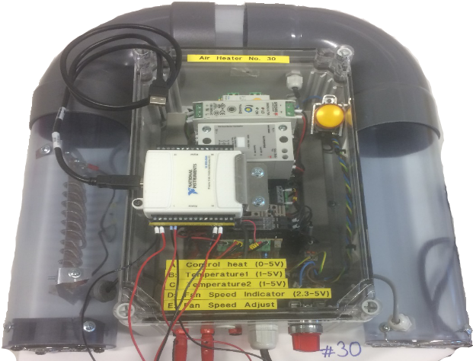
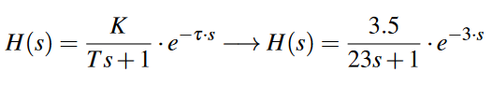
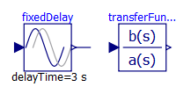
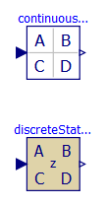
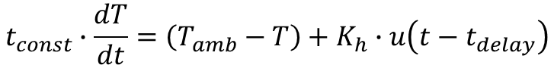
Air Heater Model
First-principles, transfer function, and state space models
First-principles:
$$t_{CONST}∙ der\left(T_{Out}\right)= \left(T_{amb}− T_{Out}\right)+ Kh∙ delay(u, 3)$$
Transfer Function:
State Space:
$$t_{const}∙\frac{dT}{dt}=\left(T_{amb}−T\right)+K_{h}∙u\left(t−t_{delay}\right)$$
Notes:
3.5 models implemented
Air heater model - Time constant with time delay process dynamics
FIRST-PRINCIPLE
Implemented as a model in Modelica based on first-principles / mechanistic model
Equation based – Heater gain, Time constant and timedelay
TRANSFERFUNCTION
Basic Modelica blocks
Time delay
Transfer function
STATE SPACE
Implemented with the use Python Control Systems Library
Build transferfunction, then use series function to merge transfer and timedelay (padé)
All models simulated in same model, with same changes in setpoint

Slide 7
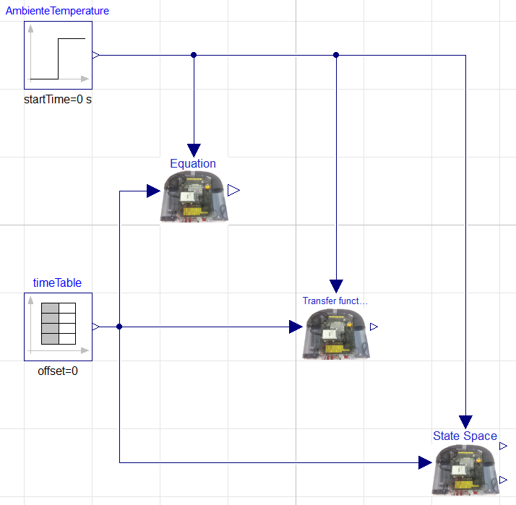
Air Heater Model
Simulation of first-principle, transfer function, and state space models
Notes:
Air heater model - Time constant with time delay process dynamics
FIRST-PRINCIPLE
Implemented as a model in Modelica based on first-principle / mechanicstic model
Equation based
TRANSFERFUNCTION
Basic Modelica blocks
Time delay
Transfer function
STATE SPACE
Implemented with the use of SciPy Python package
Build transferfunction, then use series function to merge transfer and timedelay (padé)
All models simulated in same model, with same changes in setpoint

Slide 8
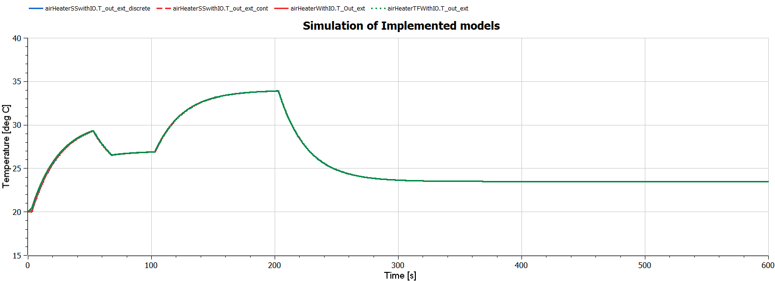
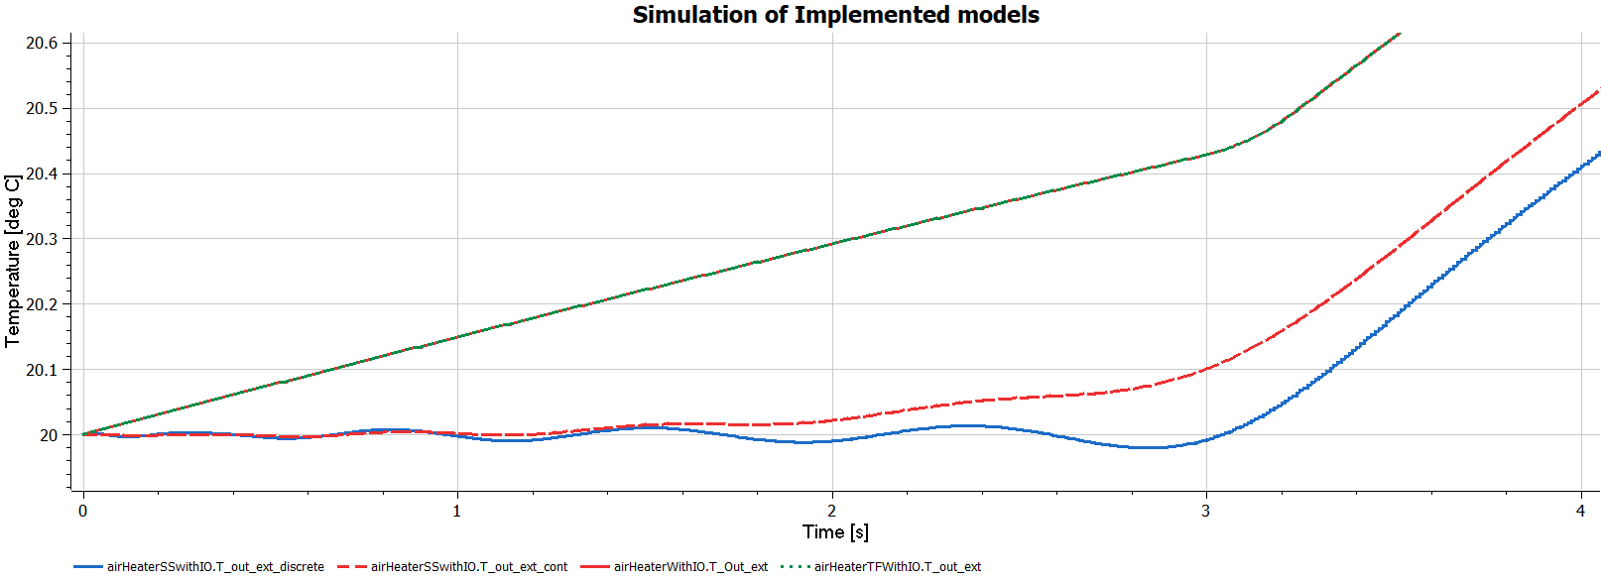
Air Heater Model
Results of first-principle, transfer function, and state space models

Slide 9
Calling External C Code in Modelica
Overview
Modelica Function
Modelica External Object
Basic functions with one return variable
Needs a Modelica block or model as a wrapper
Extended functionality and complexity
Enables reading and writing of variables from external memory across C and Modelica

Slide 10
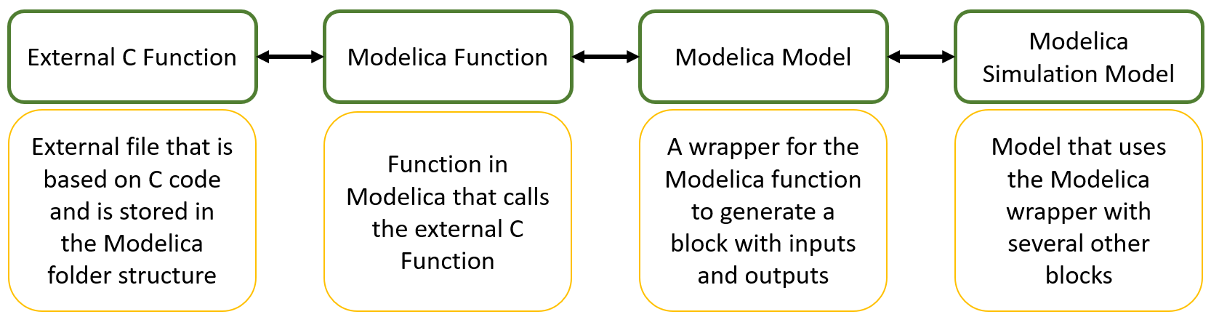
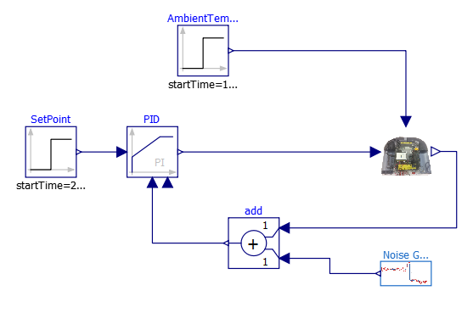
Calling External C Code in Modelica
Based on Modelica function

Slide 11
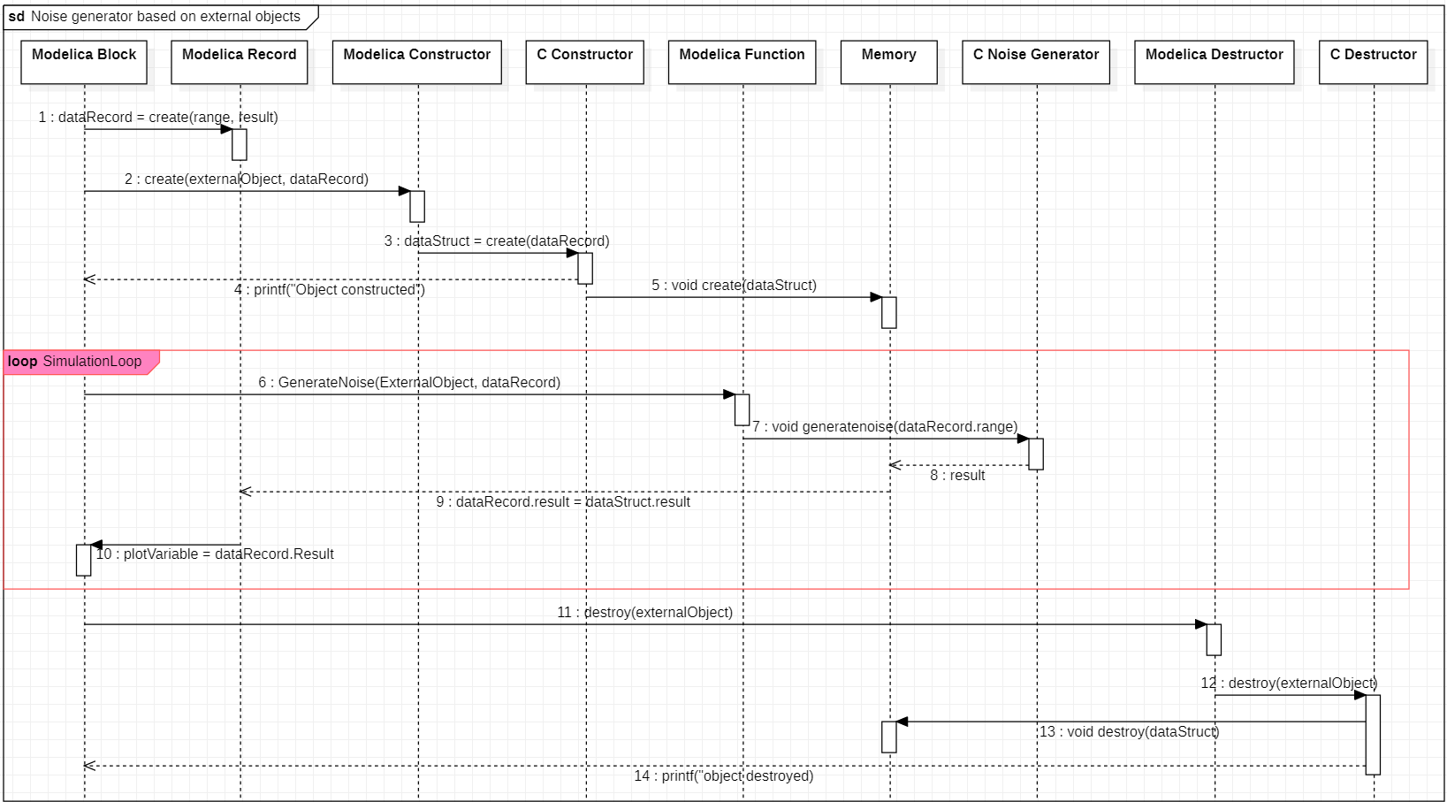
Calling External C Code in Modelica
Based on use of external objects
Notes:
Error: C Destructor writes object destroyed to the screen

Slide 12
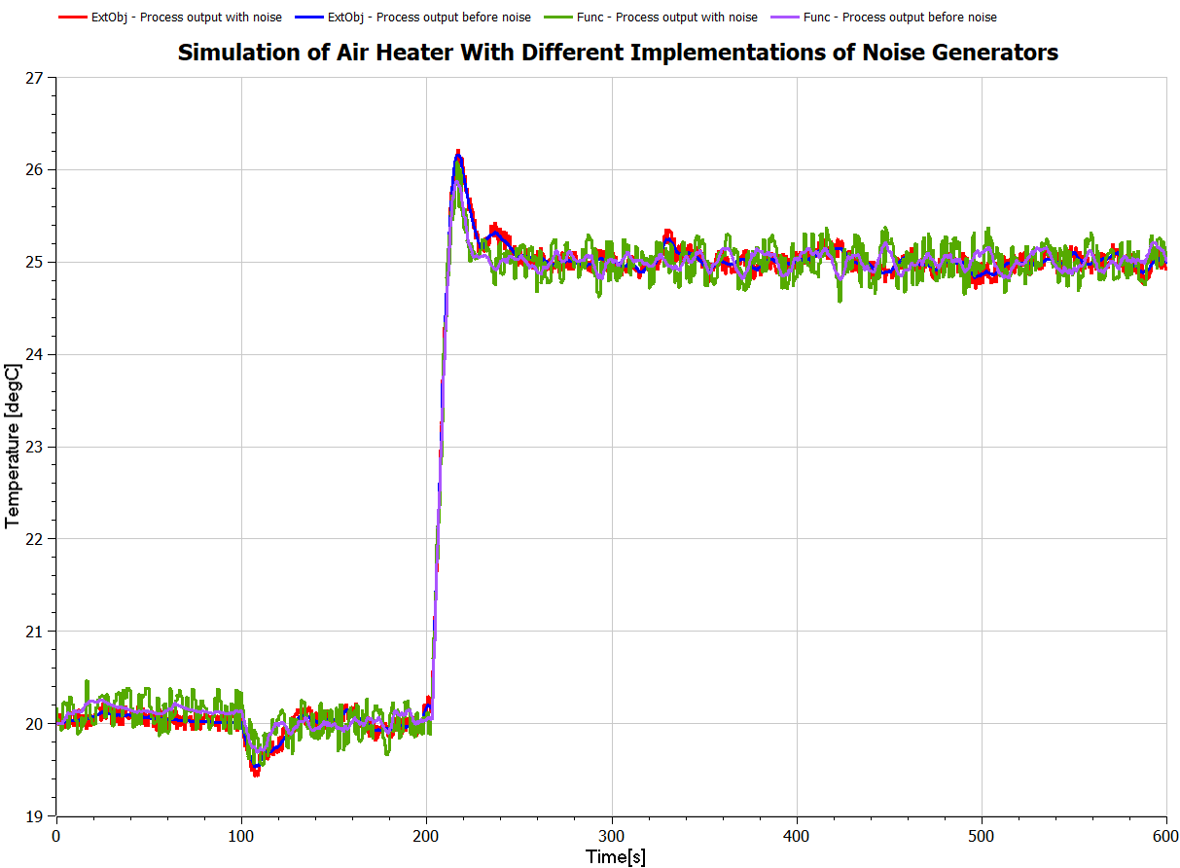
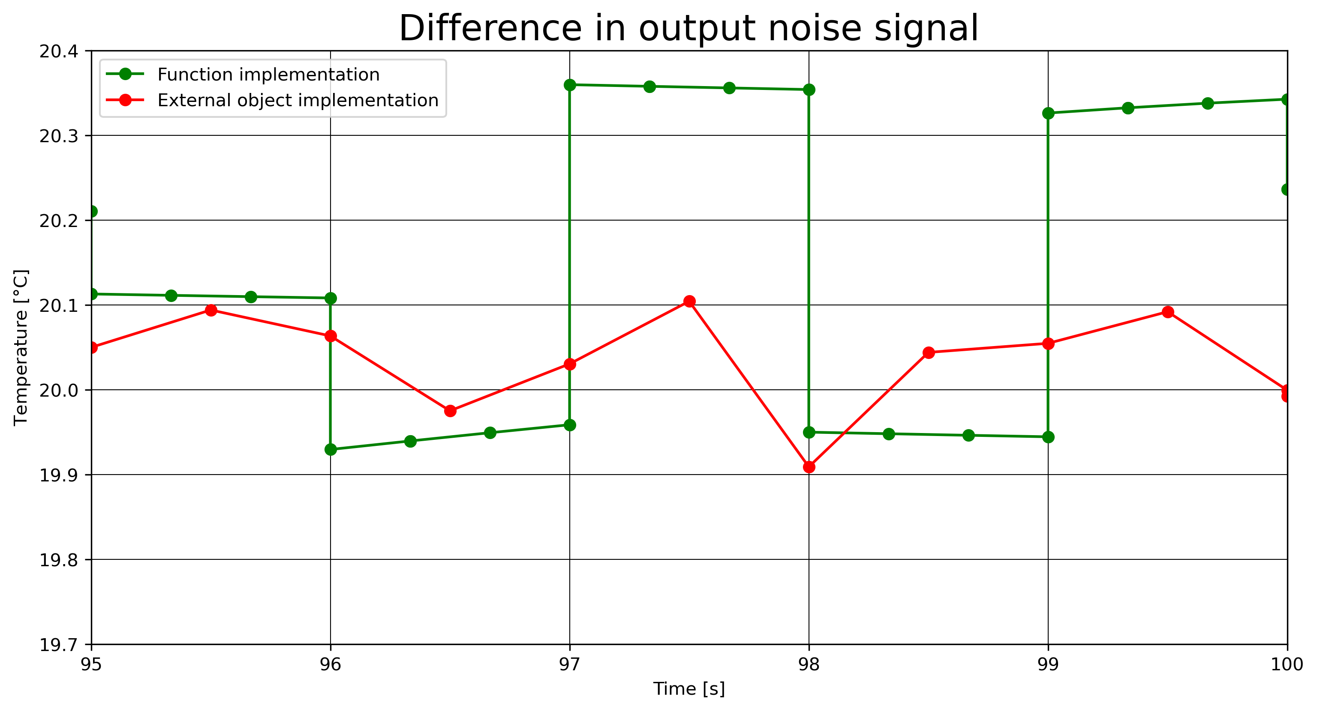
Calling External C Code in Modelica
Results

Slide 13
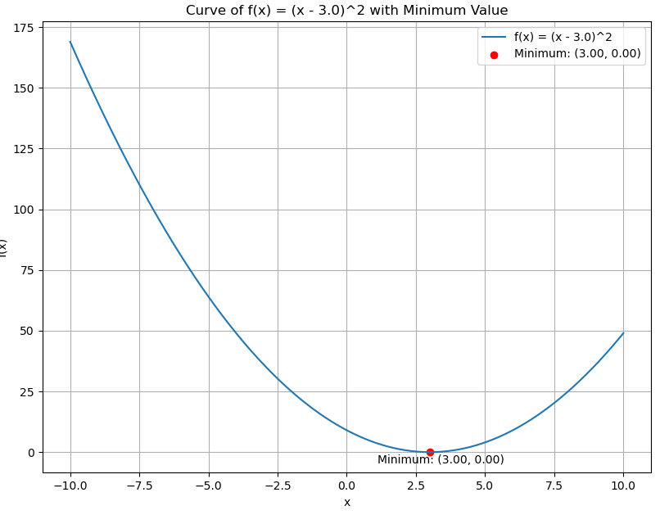
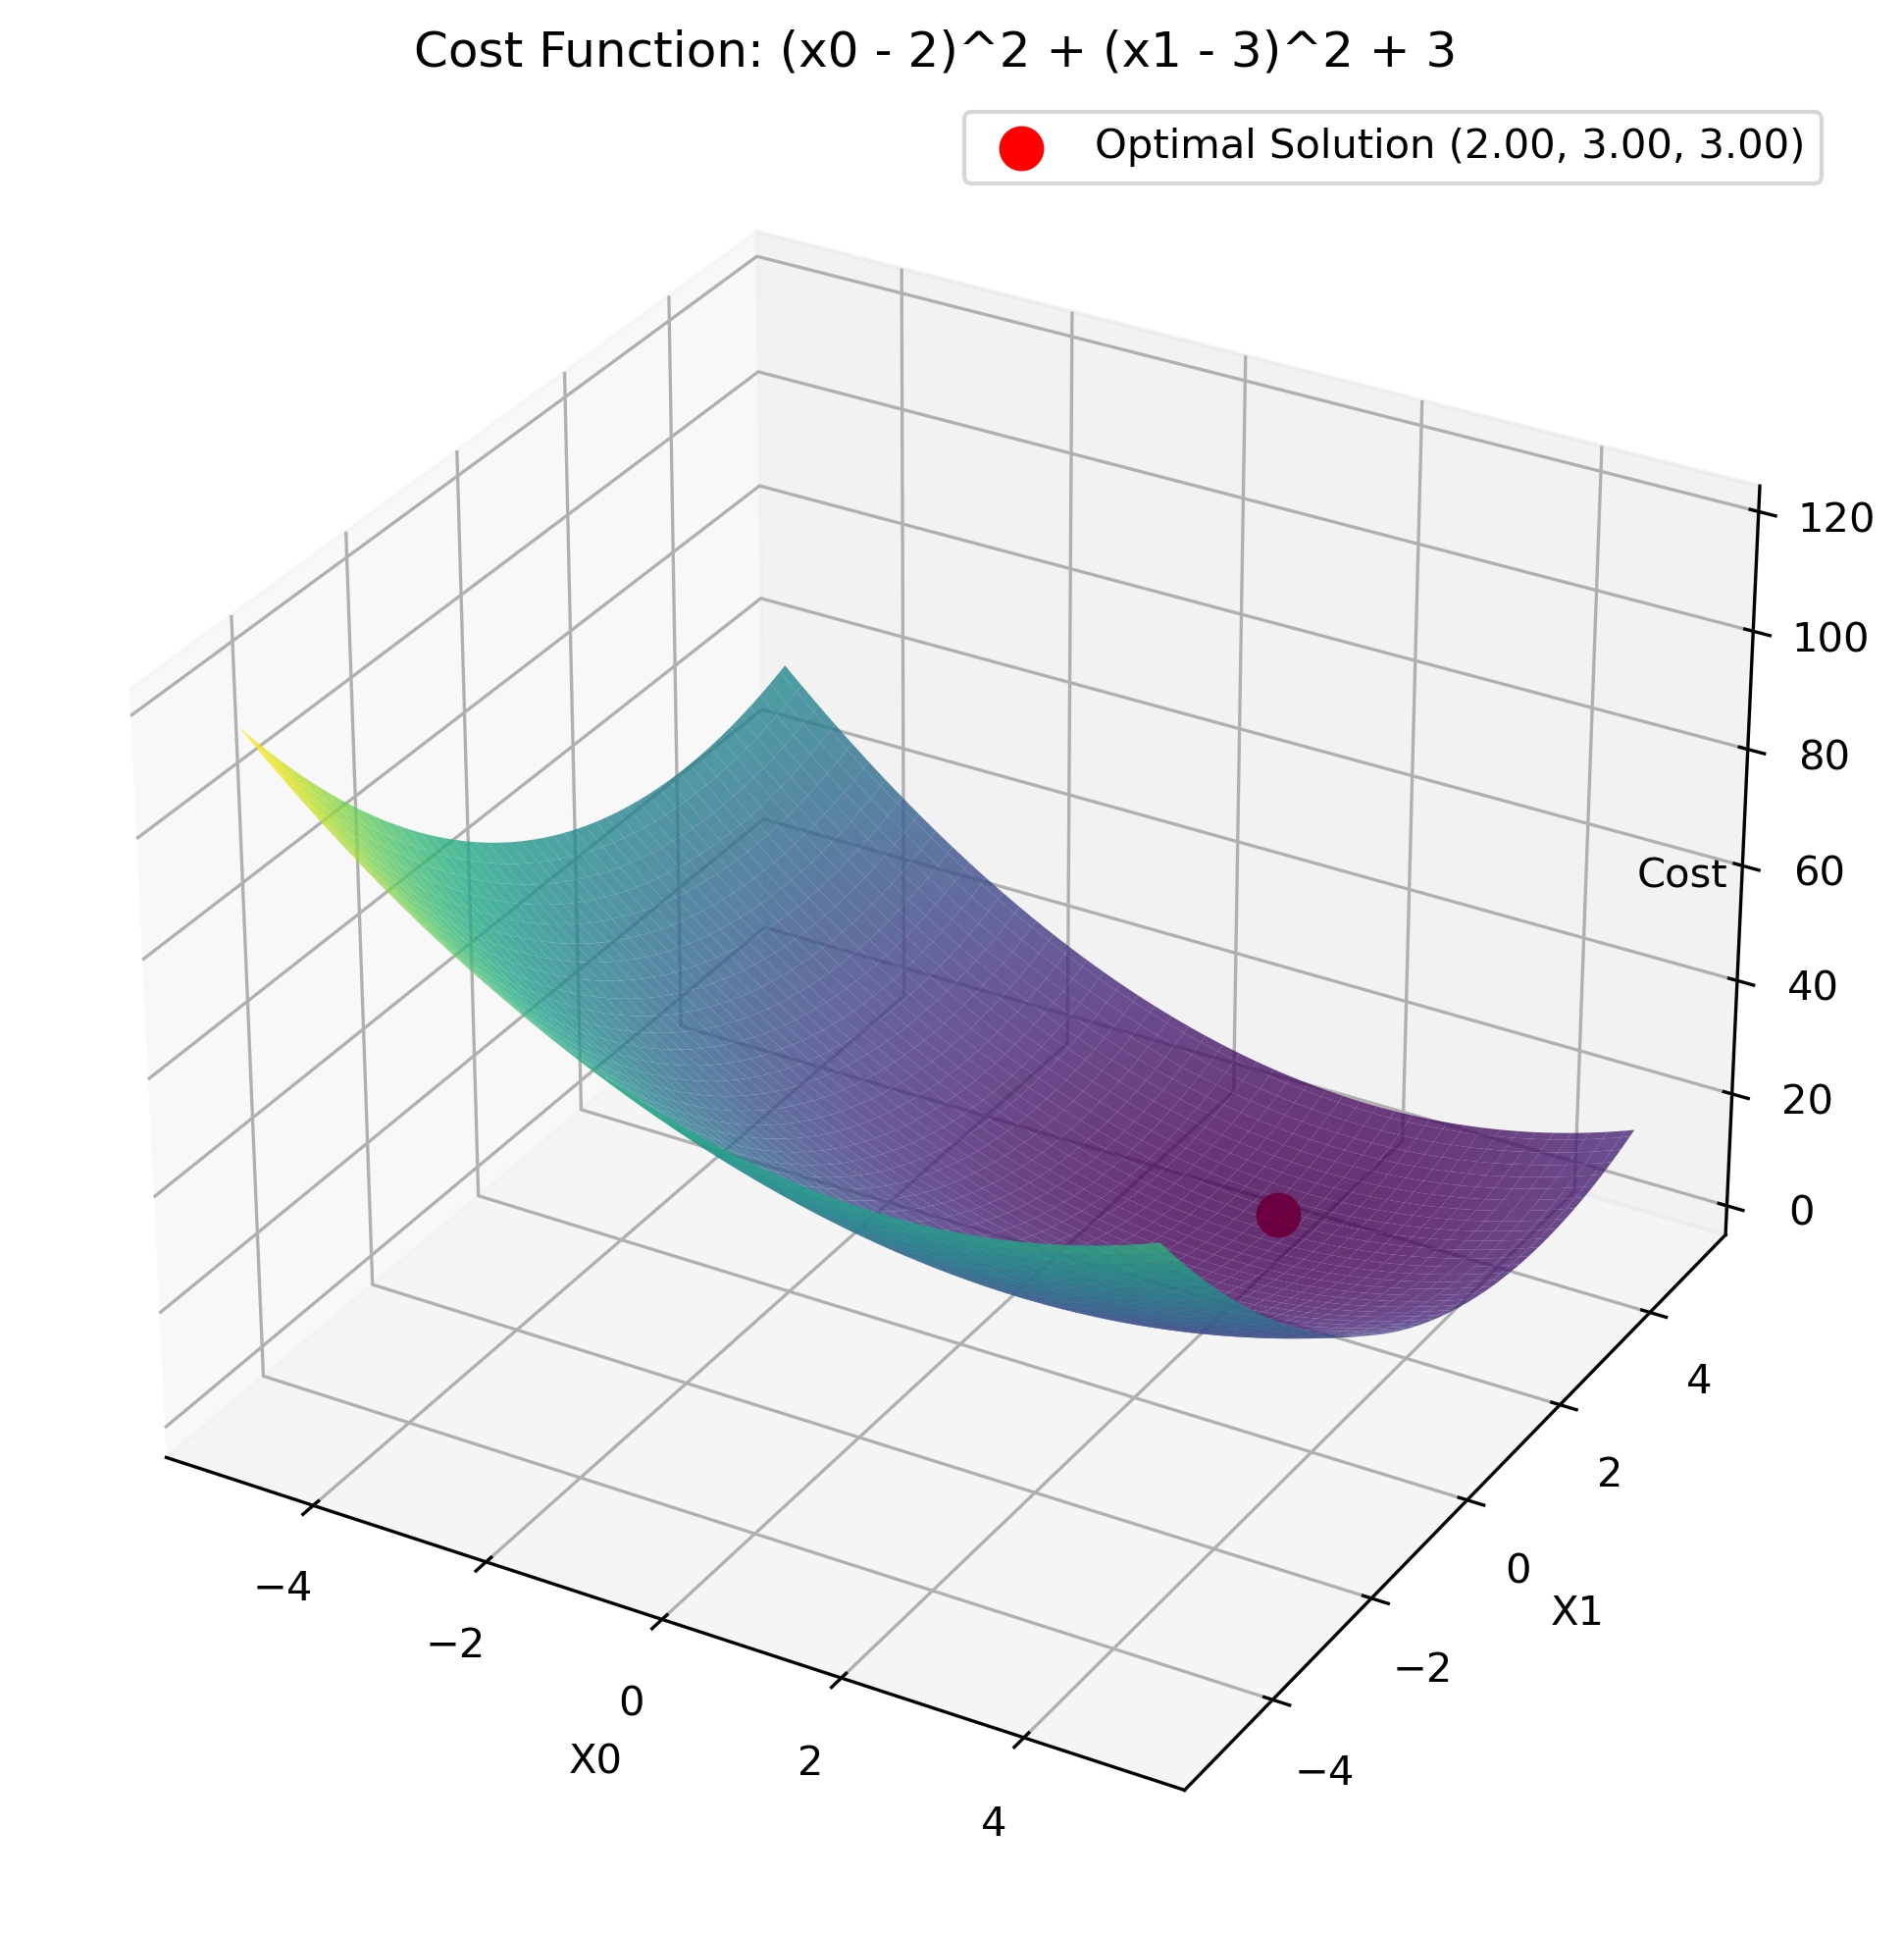
NLopt
Overview
Basic example for calling external C functions in NLopt from OpenModelica and returning values to OpenModelica
Examples of solving a univariate optimization problem in OpenModelica by calling a NLopt function in C
Examples of solving a multivariate optimization problem in OpenModelica by calling a NLopt function in C
NLopt
Version

Slide 14
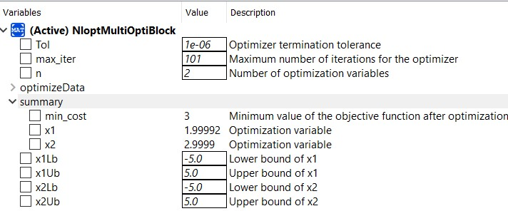
NLopt
Multivariate optimization
$$f(x) = {\left(x_{0}− 2\right)}^{2} + {\left(x_{1} − 3\right)}^{2} + 3$$

Slide 15
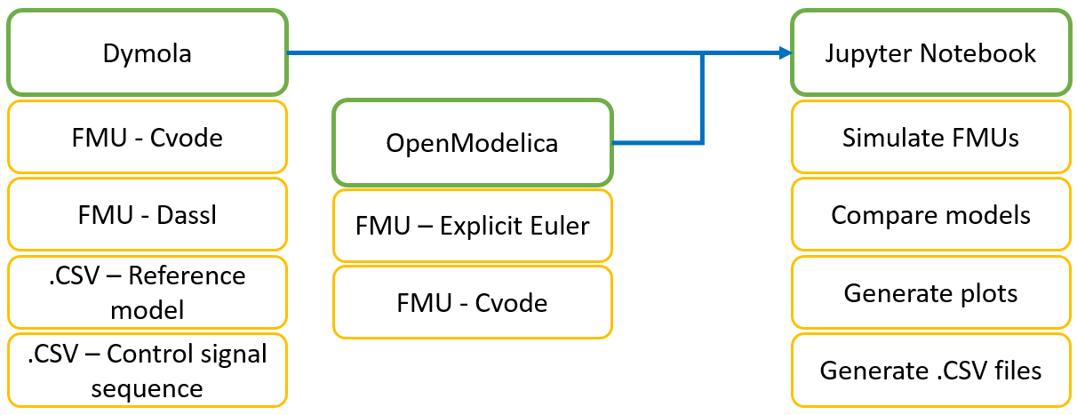
FMU of Air Heater in Python
Overview

Slide 16
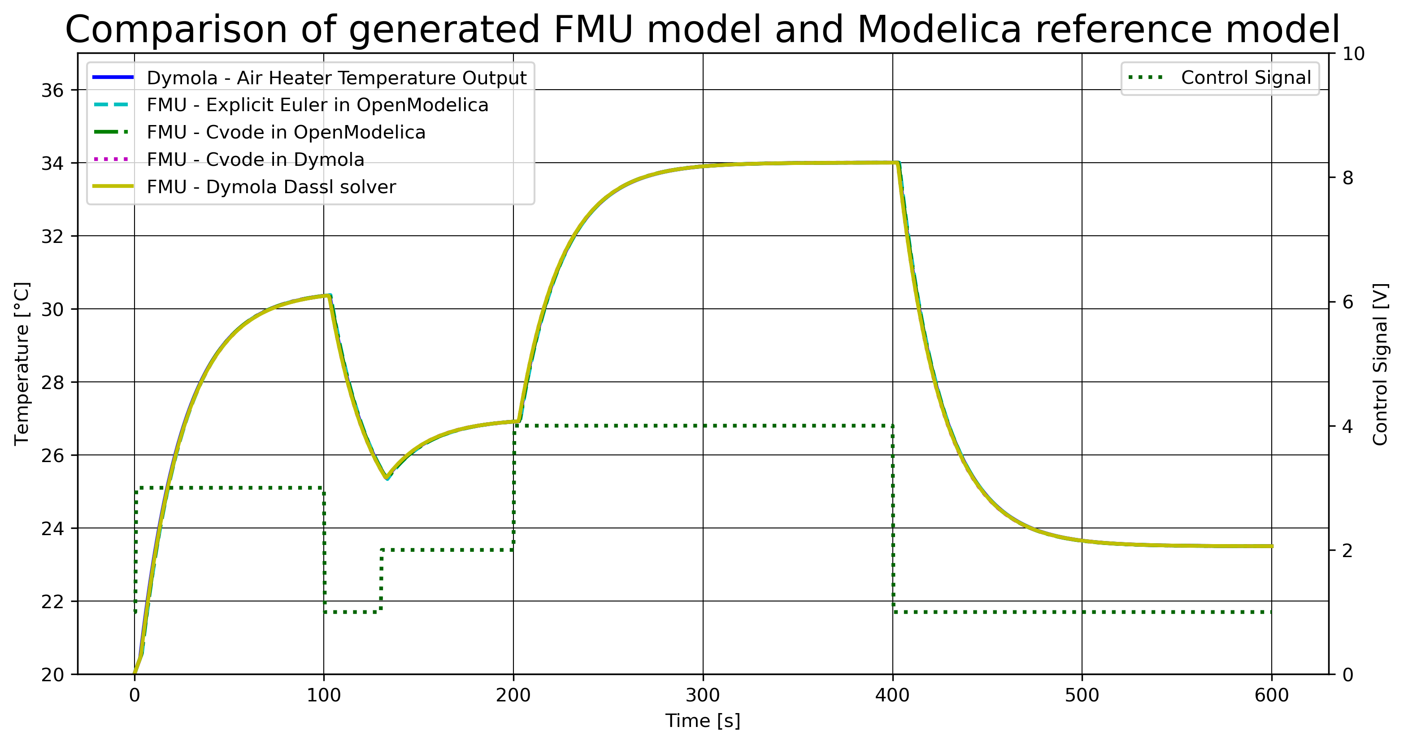
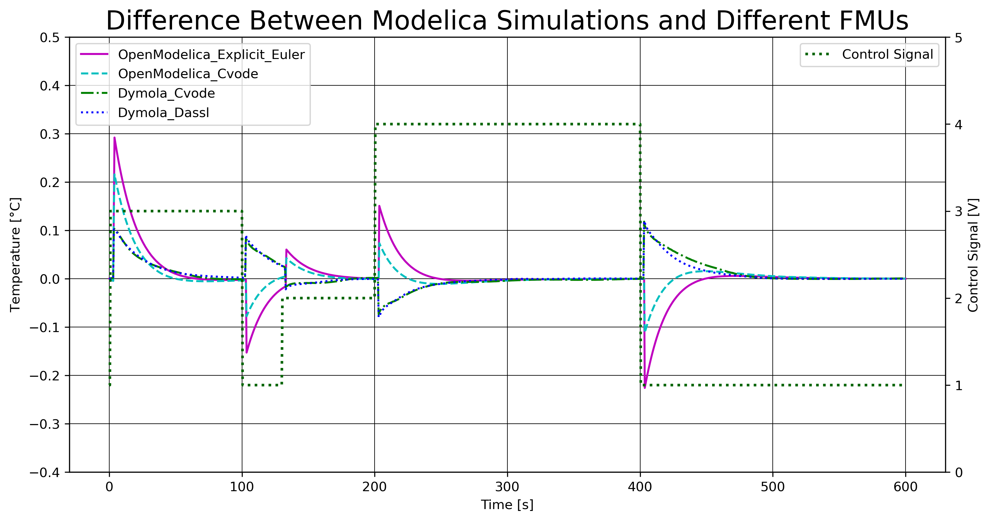
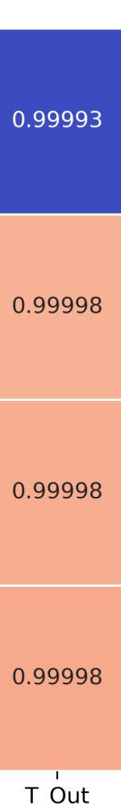
FMU of Air Heater in Python
Results
Notes:
Correlation map

Slide 17
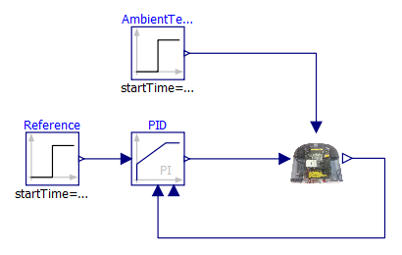
FMU of Air Heater with PI-controller in Python
Overview
Python - FMPy
OpenModelica
Set the FMU simulation parameters
Connect model value references to variables
Enables get/set in simulation
Import the air heater FMU object
Set initial values for the set values
Simulate system with doStep()
Get and set variables for each timestep in simulation

Slide 18
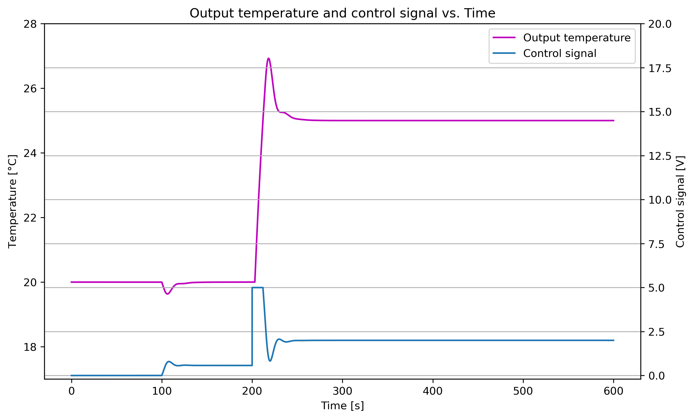
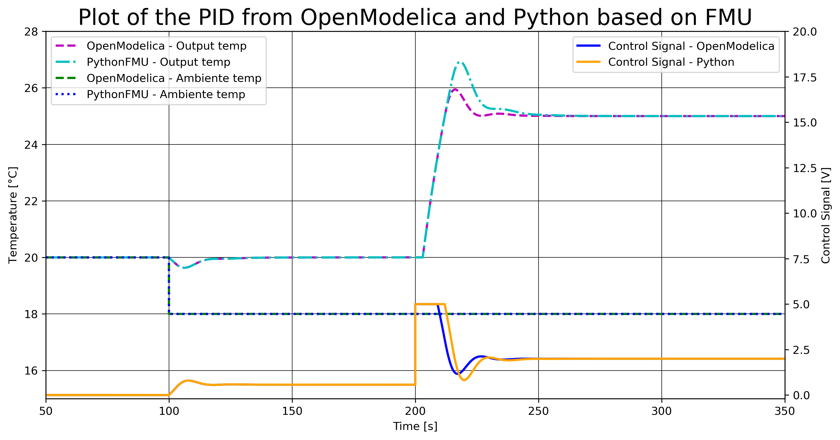
FMU of Air Heater with PI-controller in Python
Results

Slide 19
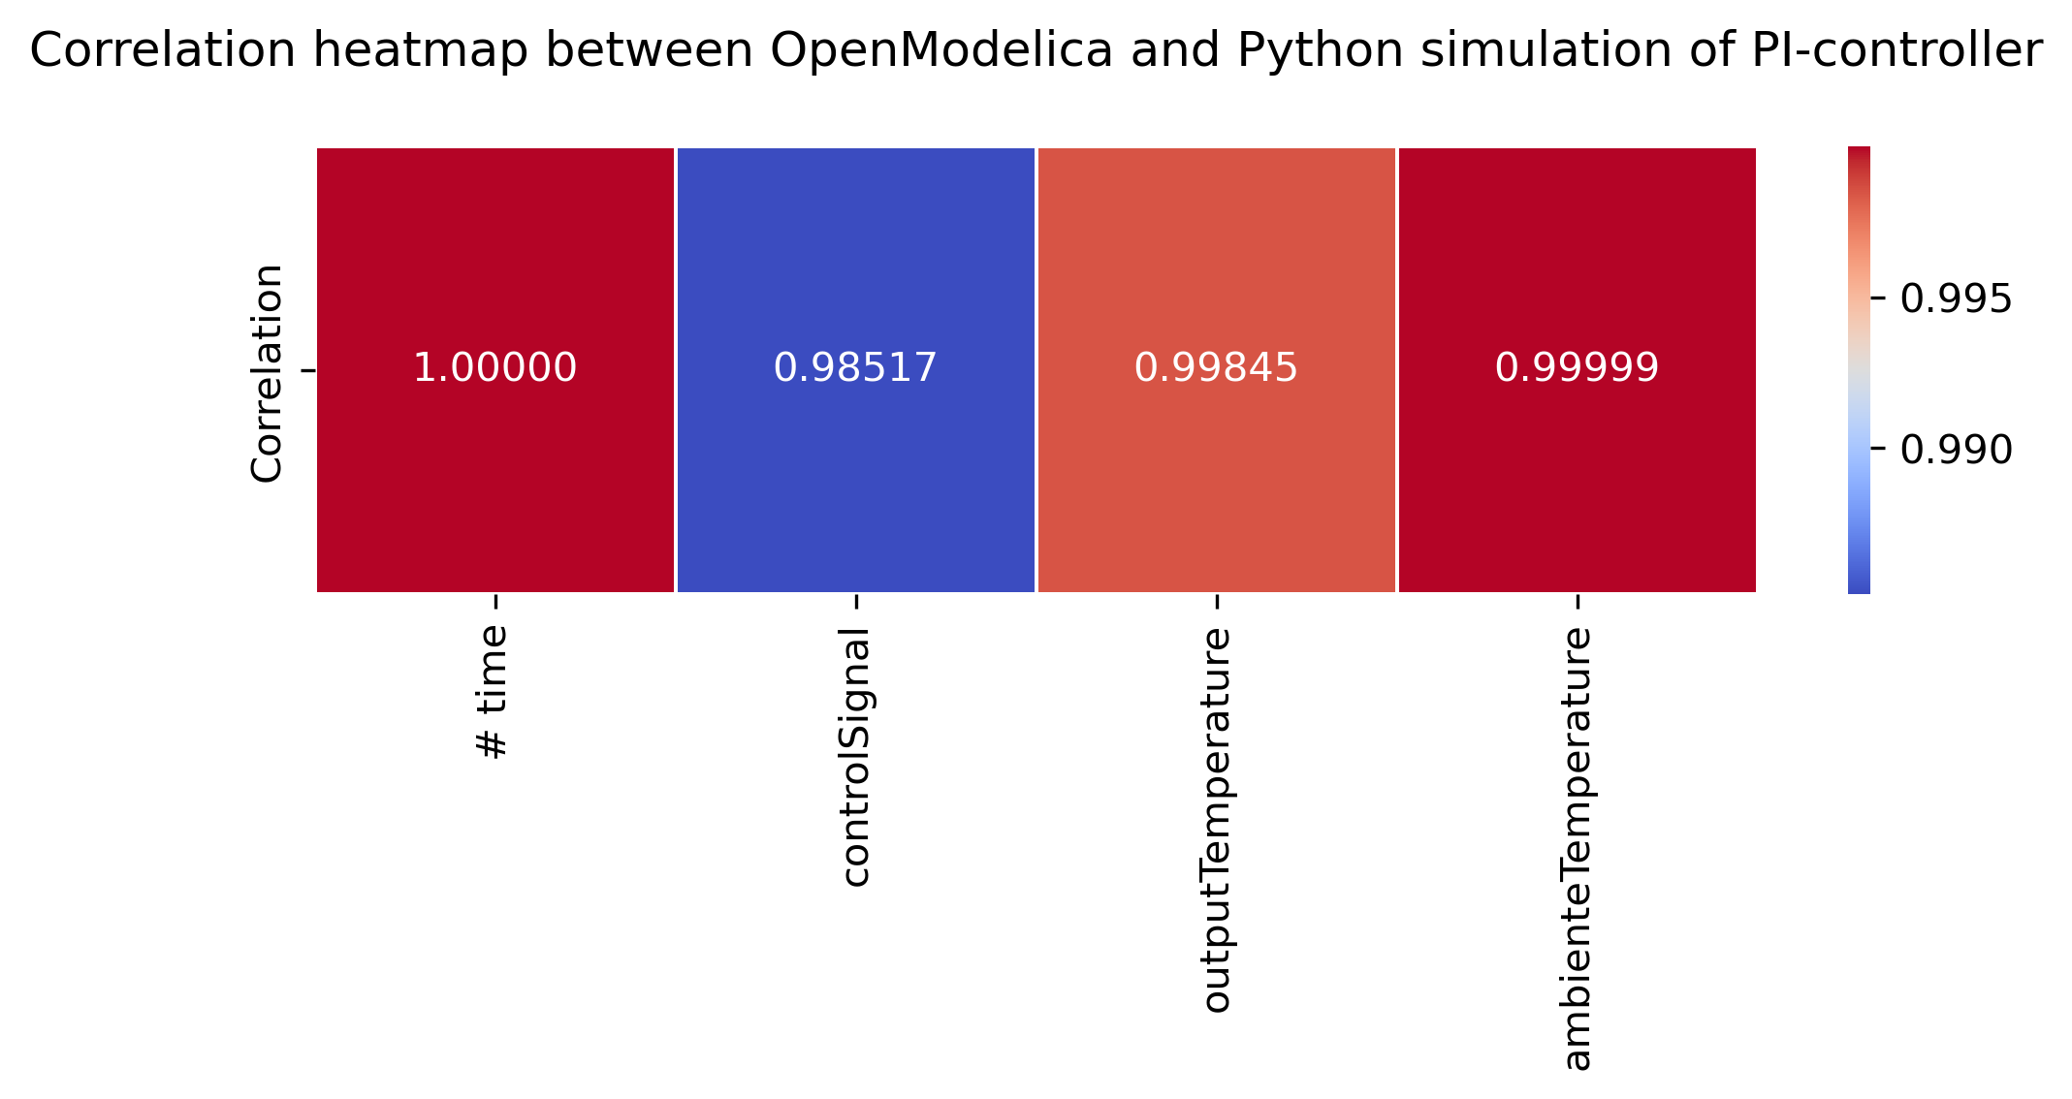
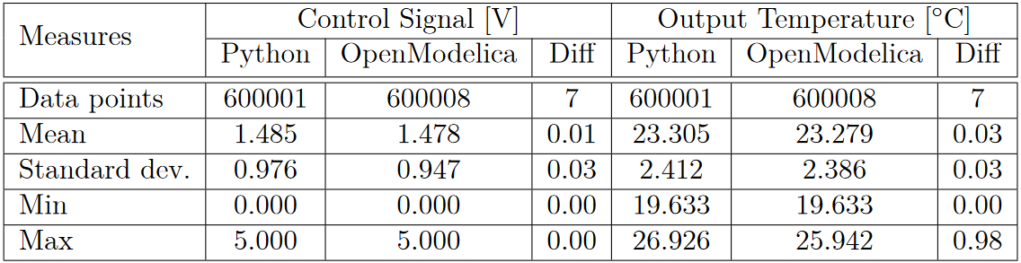
FMU of Air Heater with PI-controller in Python
Measures

Slide 20
FMU of Air Heater with MPC in Python
Overview
Python - FMPy
Set the FMU simulation parameters
Connect model value references to variables
Enables get/set in simulation
Import the air heater FMU object
Set initial values for the set values
Simulate system with doStep()
Get and set variables for each timestep in simulation

Slide 21
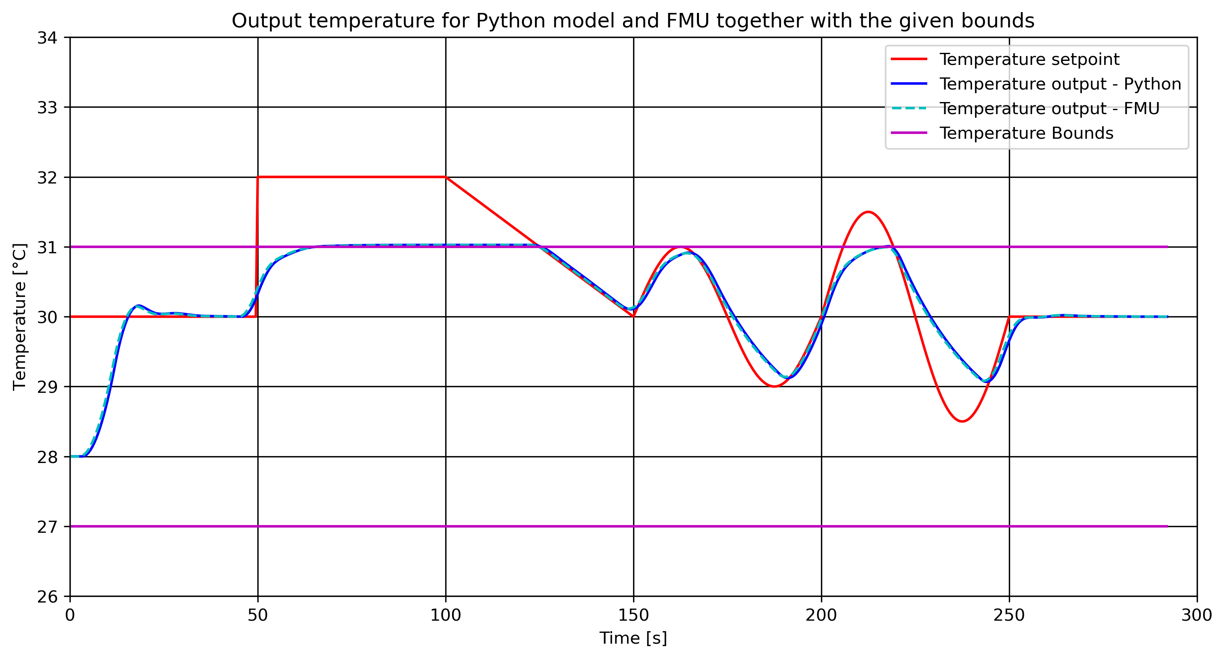
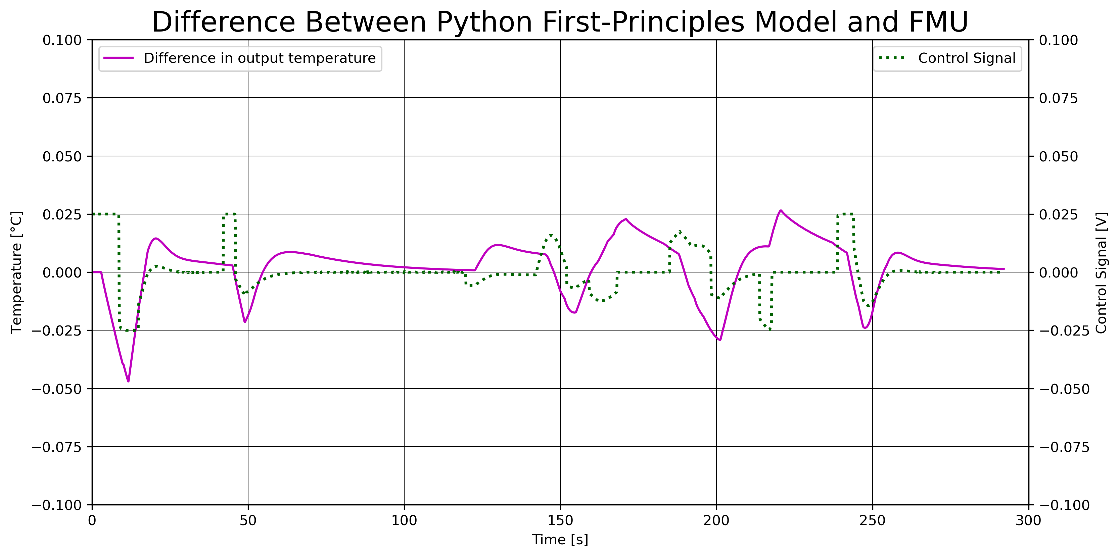
FMU of Air Heater with MPC in Python
Results

Slide 22
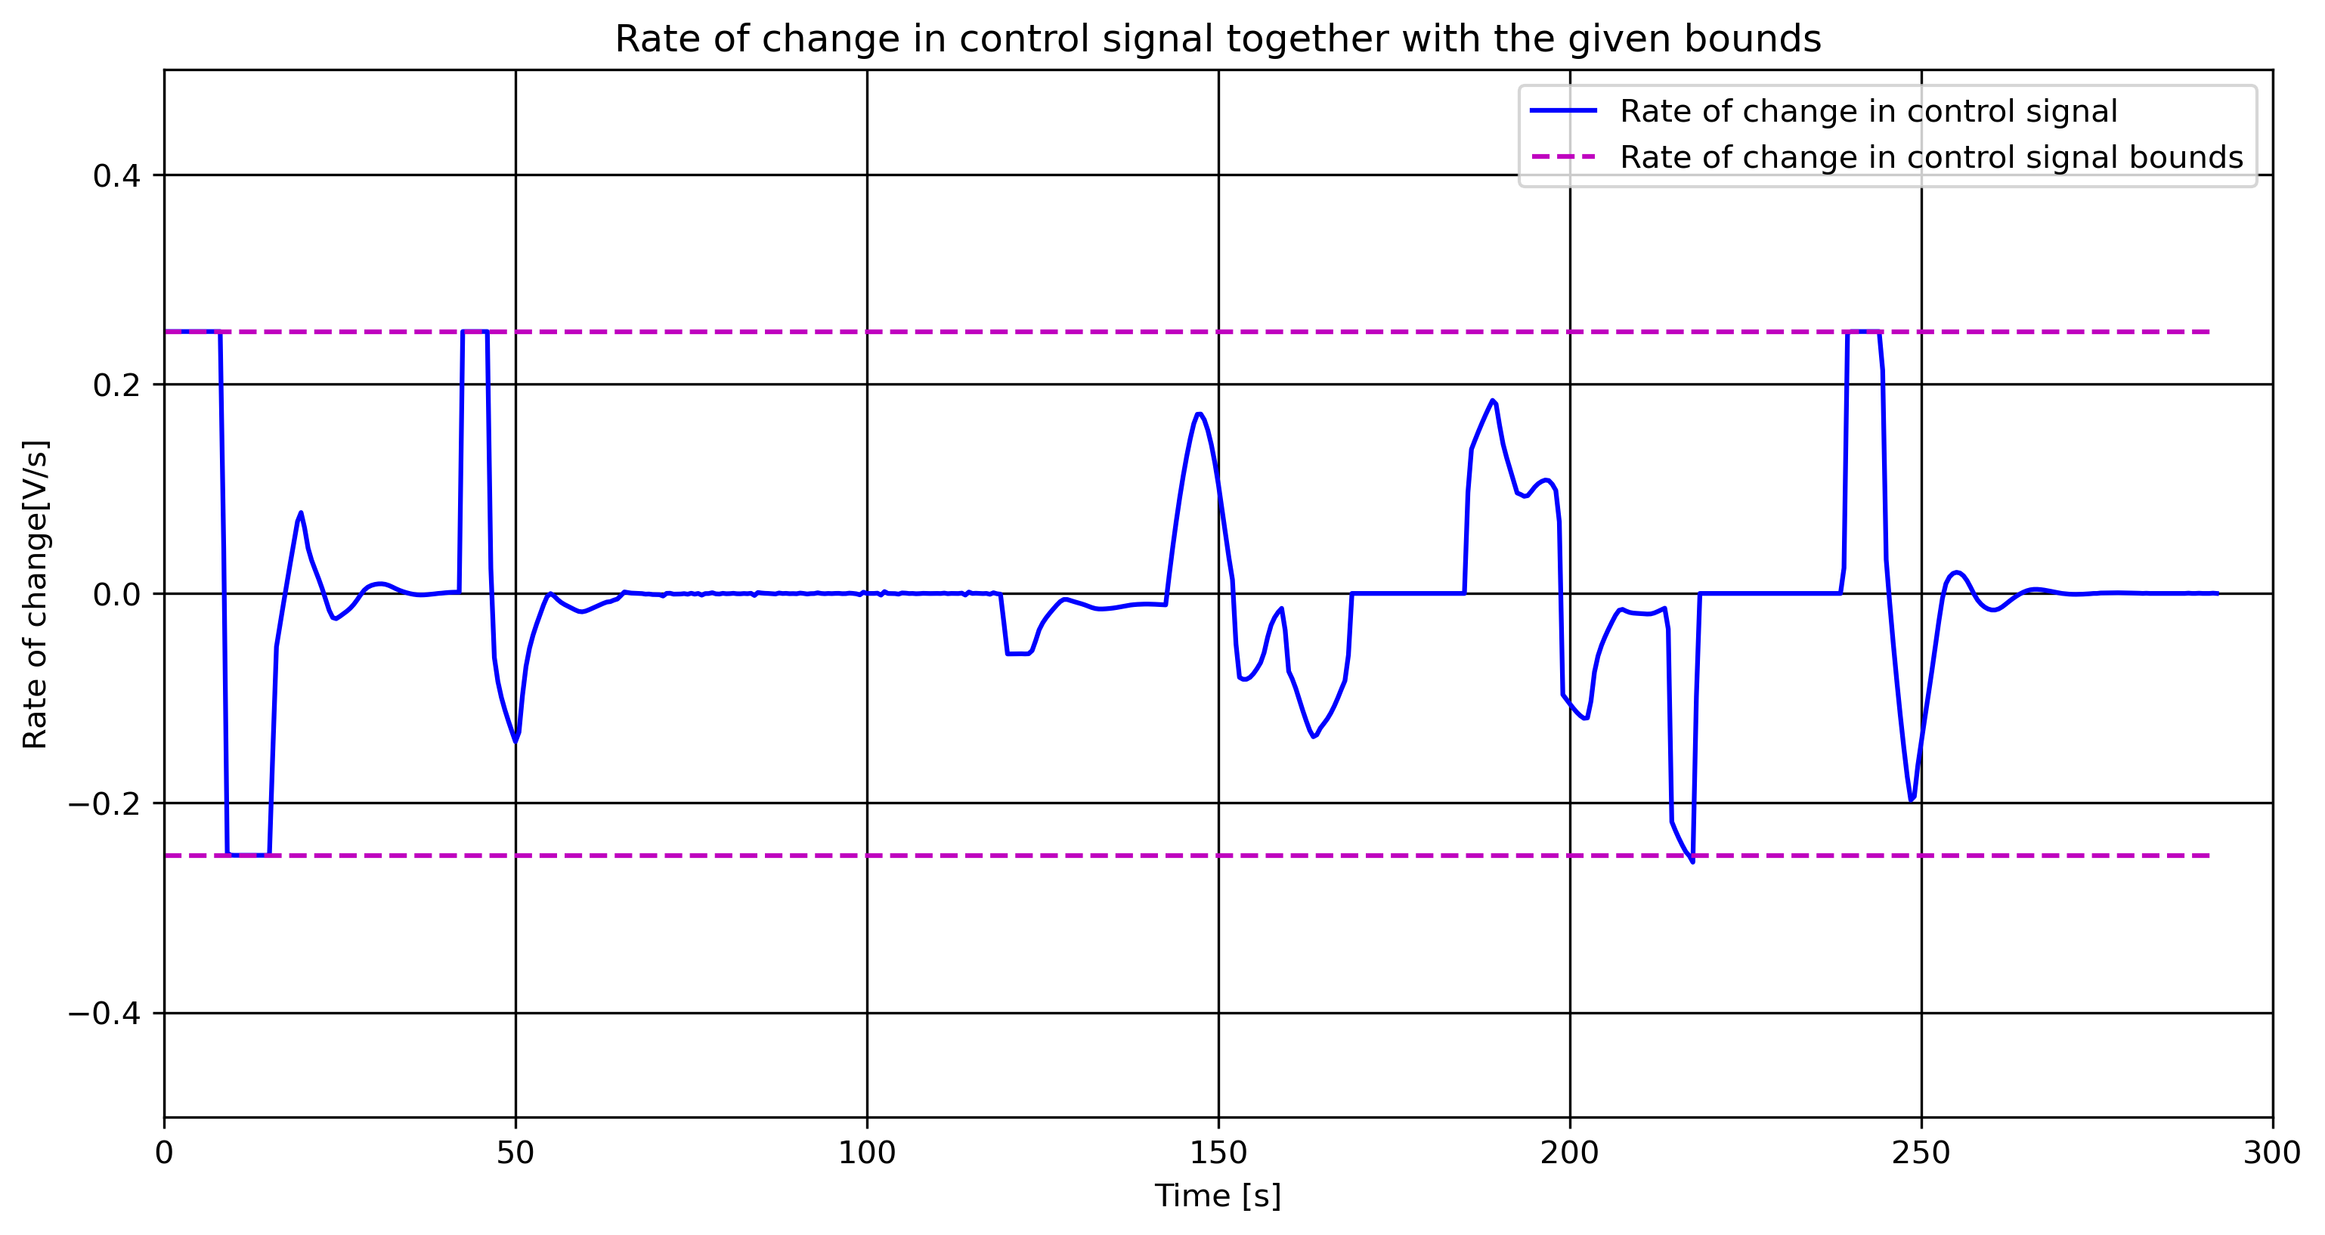
FMU of Air Heater with MPC in Python

Slide 23
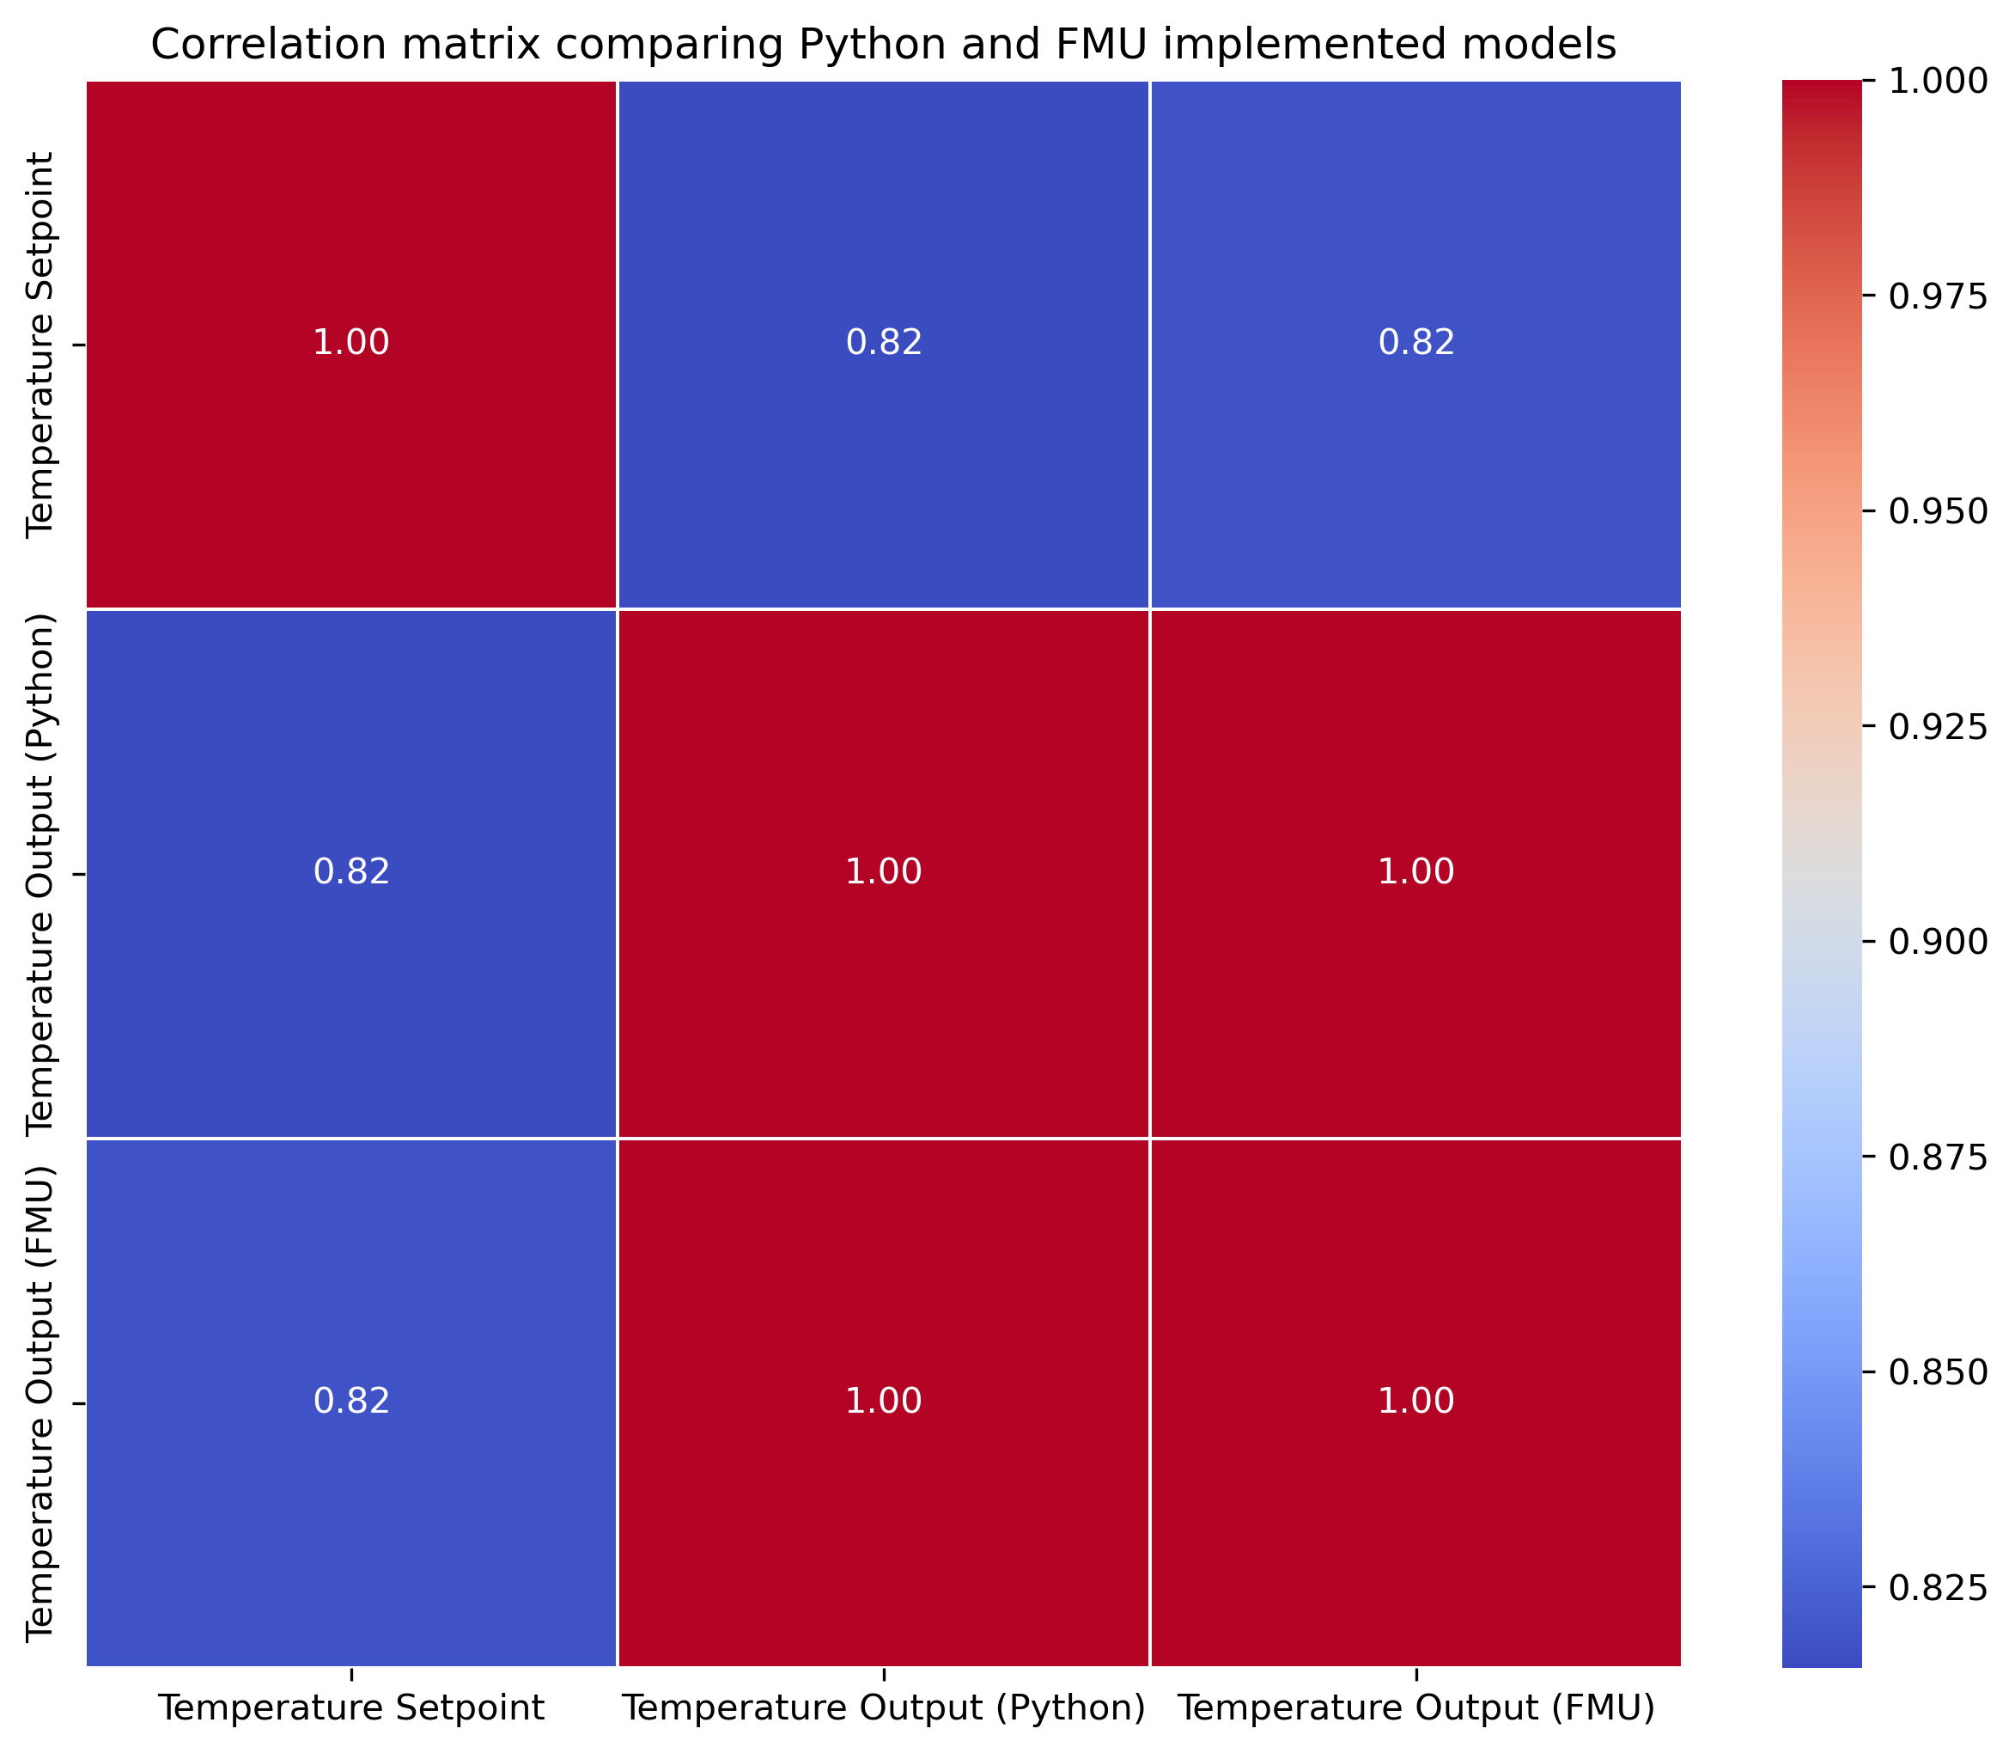
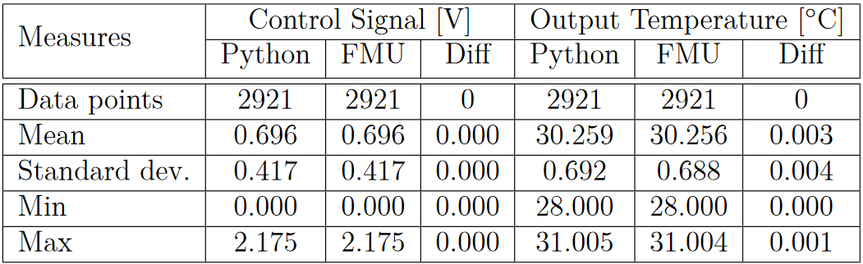
FMU of Air Heater with MPC in Python
Measures

Slide 24
Conclusion
Both methods have their strengths and weaknesses
External objects in Modelica
Fast
Complex
FMU in Python
Versatile
Widespread online support
Results for both implementations gave similar results

Slide 25
Future Work
Develop an external object in Modelica designed to utilize Functional Mock-up Units (FMUs) as models for optimization. This external object will carry out optimization tasks using parameters provided from the Modelica environment.
Notes:
Will remove the complexity to define the

Slide 26
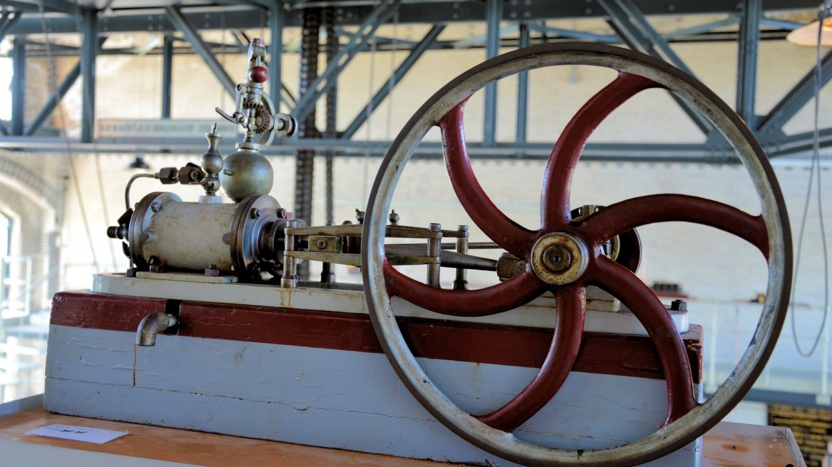
Thank you for the attention

Slide 27
Introduction
Modelica
Equation-Based Modeling:
Uses equations for dynamic system representation
Open Standard:
Collaboration among different simulation tools, libraries, and Modelica-compliant environments
Multi-Domain Support:
Model complex systems across diverse domains
Graphical and Text-Based Options:
Offers flexibility with both graphical and text-based modeling
Functional Mock-up Unit (FMU) for Interconnectivity:
Supports Functional Mock-up Units for model exchange and co-simulation
Notes:
Equation-Based Modeling:
Modelica uses equations to describe system behavior, allowing for a natural representation of dynamic systems.
Multi-Domain Support:
It's designed to model complex systems across diverse engineering domains like electrical, mechanical, thermal, and fluid systems.
Functional Mock-up Units (FMUs):
ModelExchange-needs external solver – Simple and fast ; Co-simulation-FMU includes solver – Flexible and slower
Vendor neutral
Declarative Modeling:
The language takes a declarative approach, focusing on defining relationships between variables rather than specifying solution algorithms(procedual).
Graphical and Textual Options:
MODELICA STANDARD LIBRARY
1600 components and 1350 distinct function

Slide 28
DRAFTS

Slide 29
Existing Options
JModelica
Discontinued in 2019
Three packages moved to GitHub:
Assimulo
Python simulation packages
PyFMI
Load and simulate FMUs
FMI Library
C package to load and simulate FMUs

Slide 30
Existing Options
FMPy - Dassault Systèmes
Free Python library
Graphical user interface
Validate FMUs
Export to Jupyter Notebook, Modelica and Cmake
Read model data
Web App to share FMUs with anyone in a browser

Slide 31
Existing Options
NLopt
Open-source library
C, C++, MATLAB, Fortran, Python among others
Collection of several algorithms from different contributors
Set up the Optimizer Object
Set up Objective Function
Set Bounds
Optimize the Problem!
Define optimizer algorithm and number of optimization variables
Combine the optimizer object and the function to be optimized
Set upper, lower, equality and inequality bounds based on algorithm capability
Use the optimizer together with the defined minimum cost and the optimization variable

Slide 32
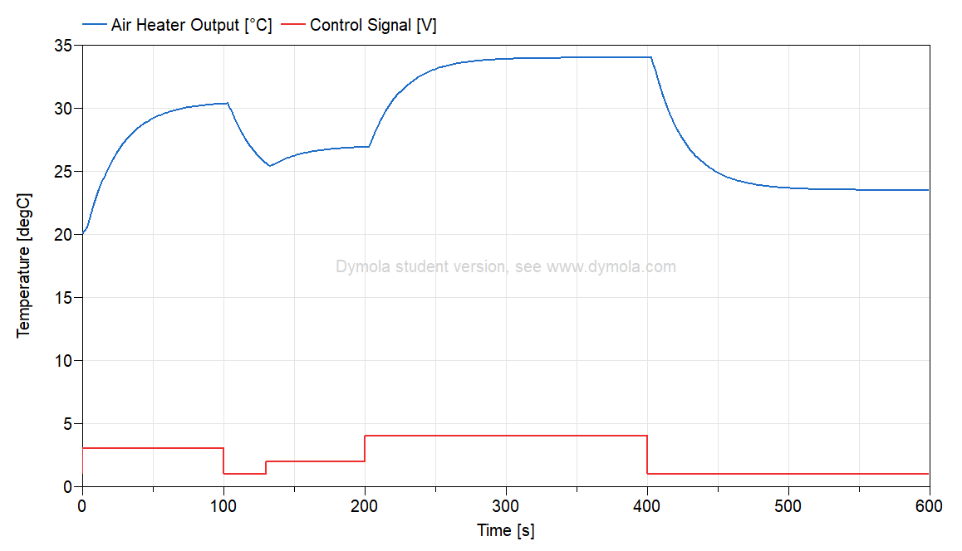
Air Heater Model
First-principles model in Modelica
$$T_{CONST}∙ der\left(T_{Out}\right)= \left(T_{amb}− T_{Out}\right)+ Kh∙ delay(u, 3)$$
Notes:
Air heater model - Time constant with time delay process dynamics
Implemented as a model in Modelica

Slide 33
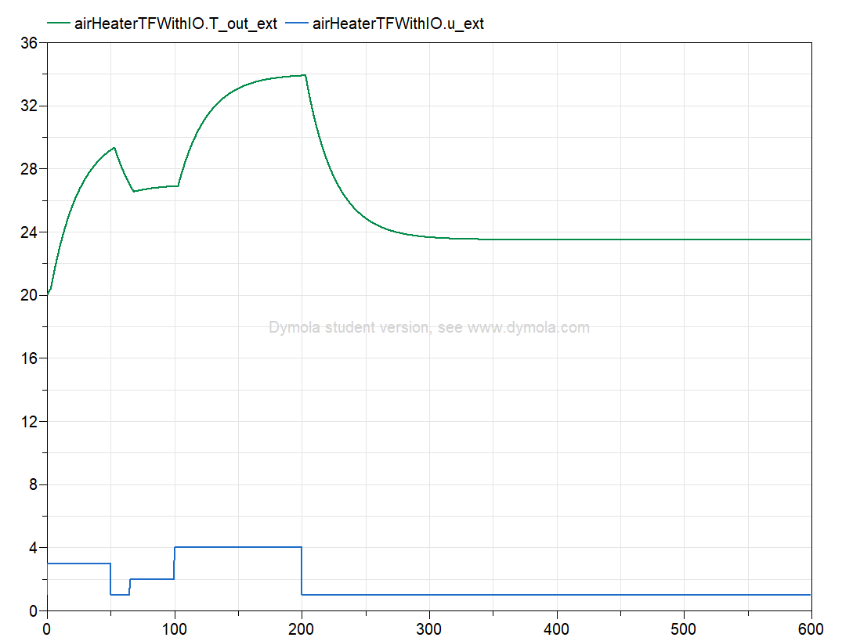
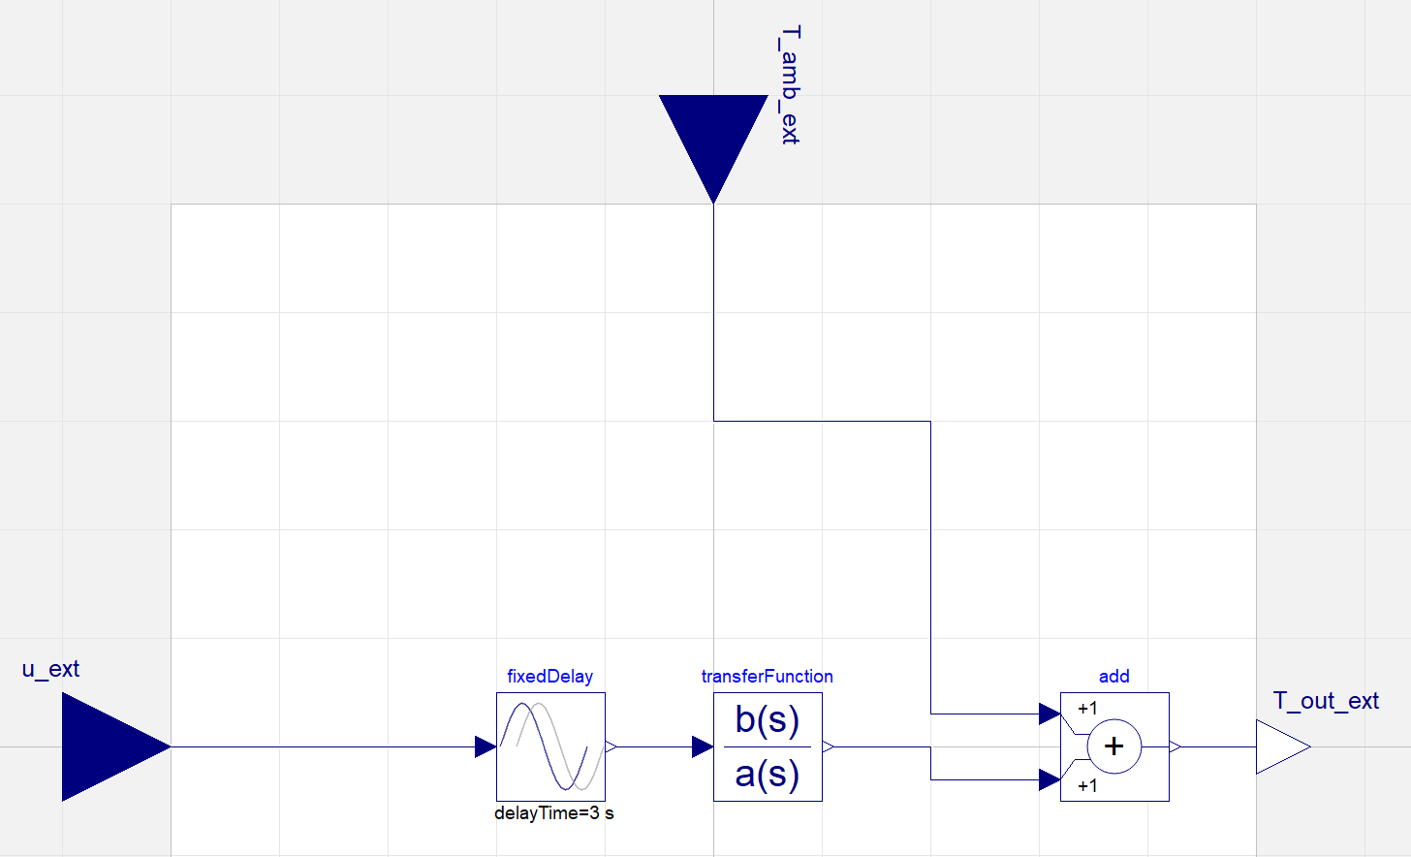
Air Heater Model
Transfer function

Slide 34
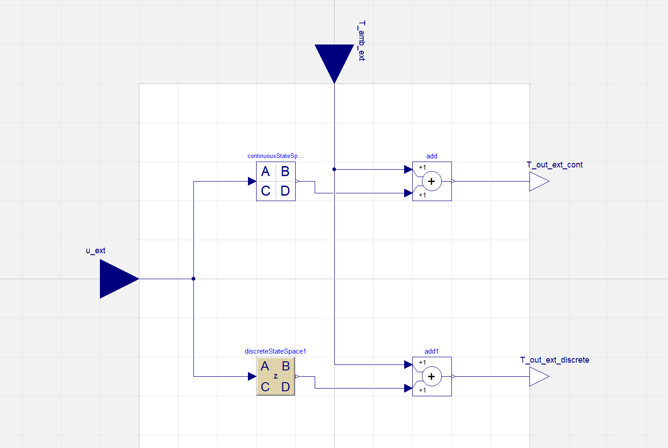
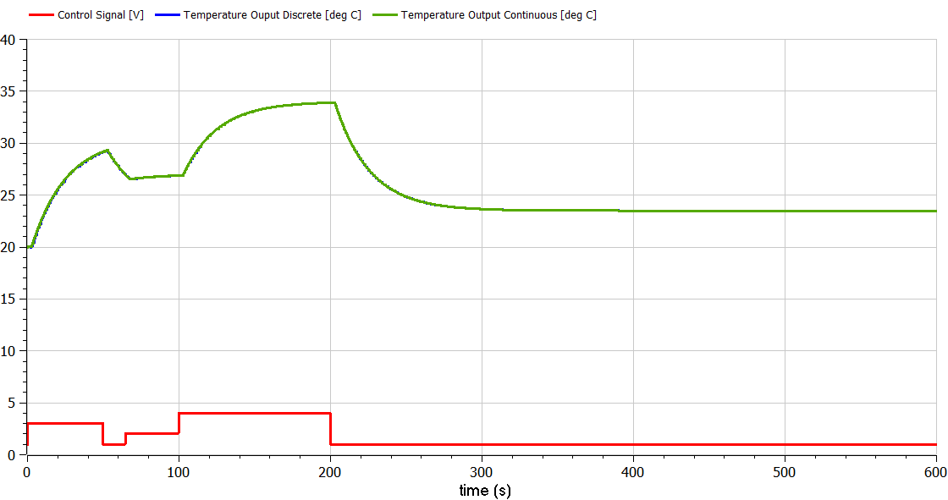
Air Heater Model
State space models

Slide 35
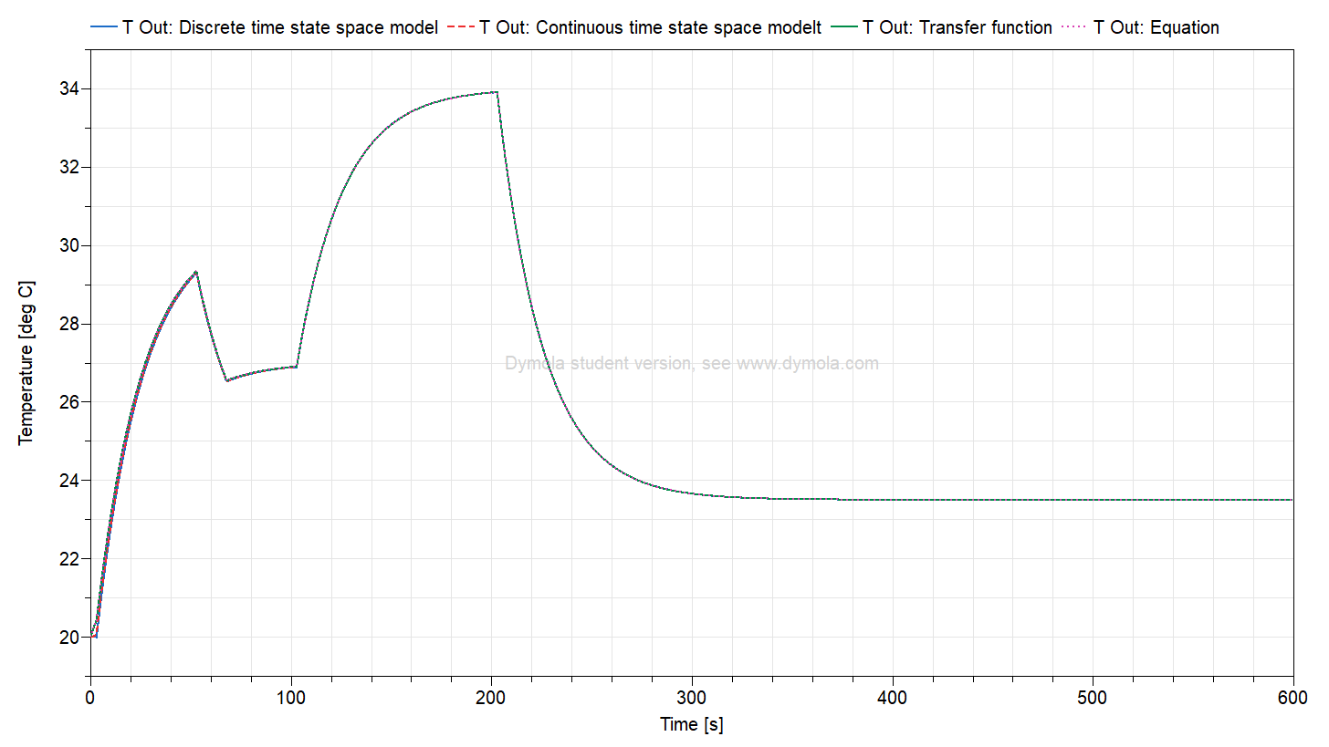
Air Heater Model
Model evaluation

